Slide 1
Critical Design Review
3/9/2023

Slide 2
Hardware

Slide 3
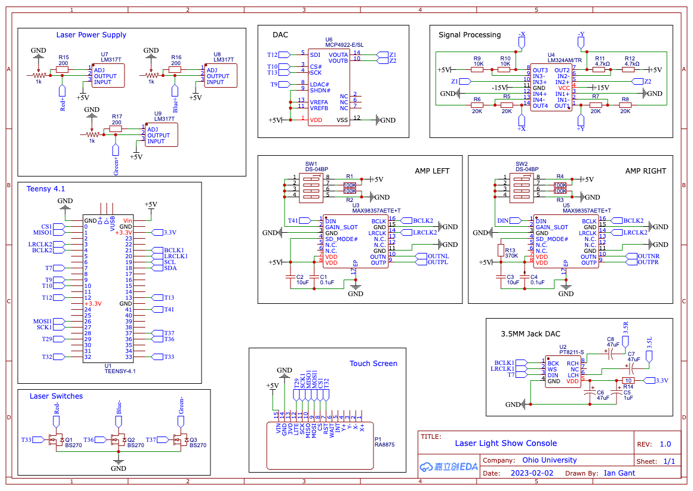
Notes:
Ian:

Slide 4
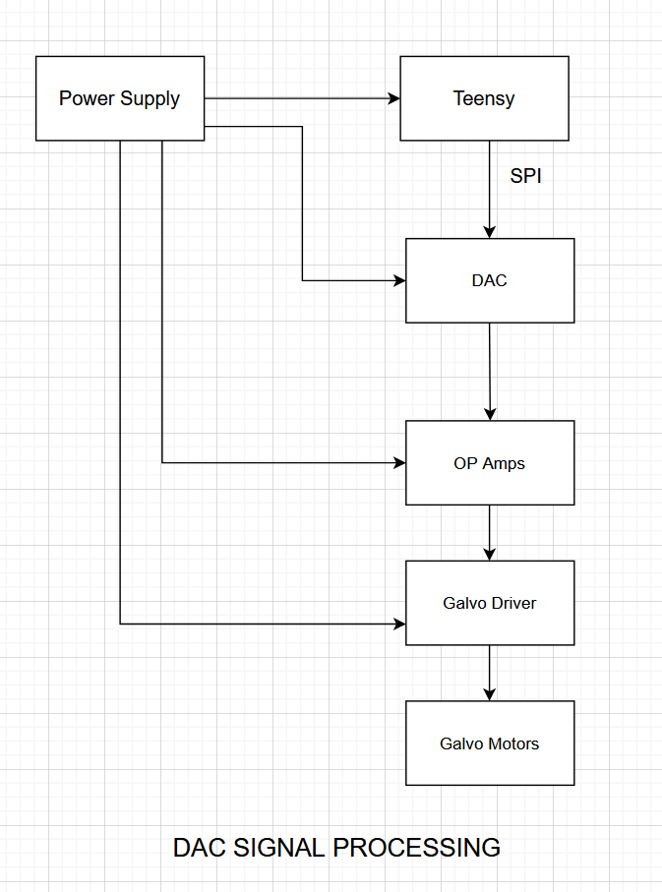
Galvo Control Flowchart
Code sends a value (0-4095 u12) to the dac using SPI, value is stored at one of two registers depending on what galvo.
DAC takes value, and maps it to a (0-5v) signal
DAC Signal Processing takes the 0-5v signal, and converts it to a -5v / +5v differential signal
Differential signal is fed into the galvo driver, when then control the galvos
Notes:
Ian

Slide 5
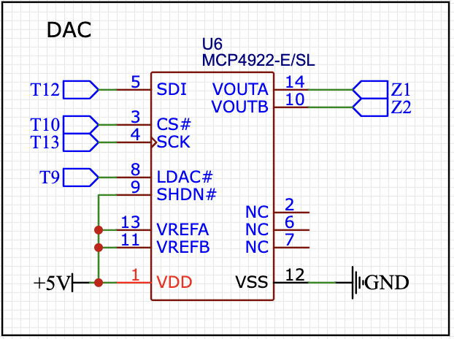
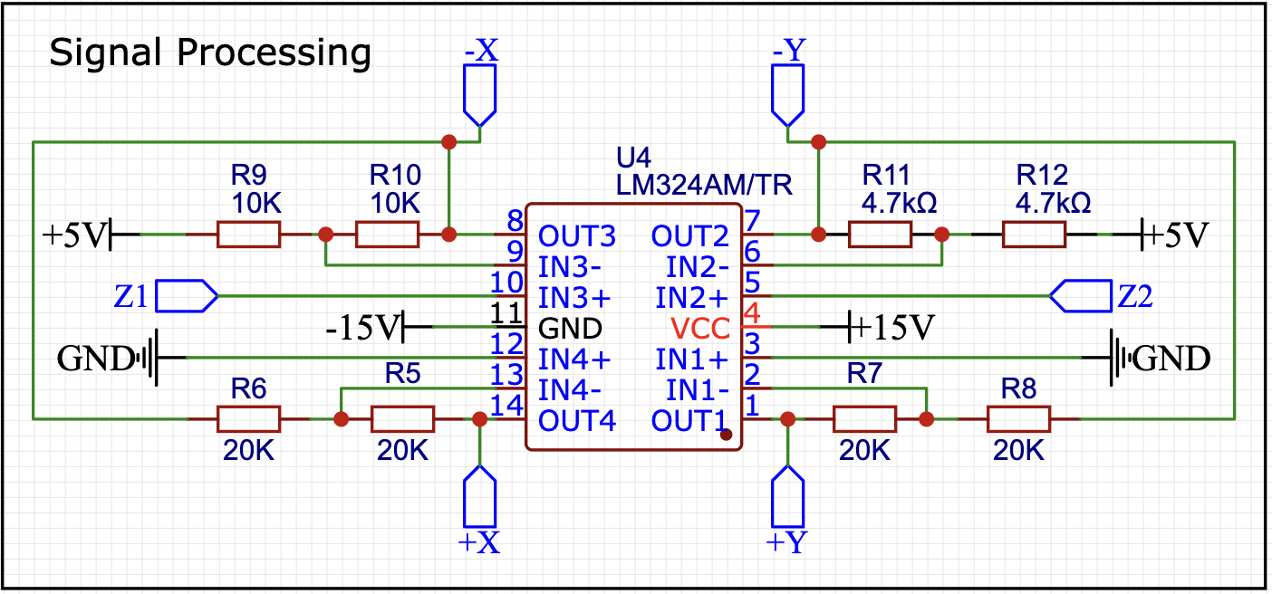
Galvo Control Circuit Schematic
Notes:
Ian

Slide 6
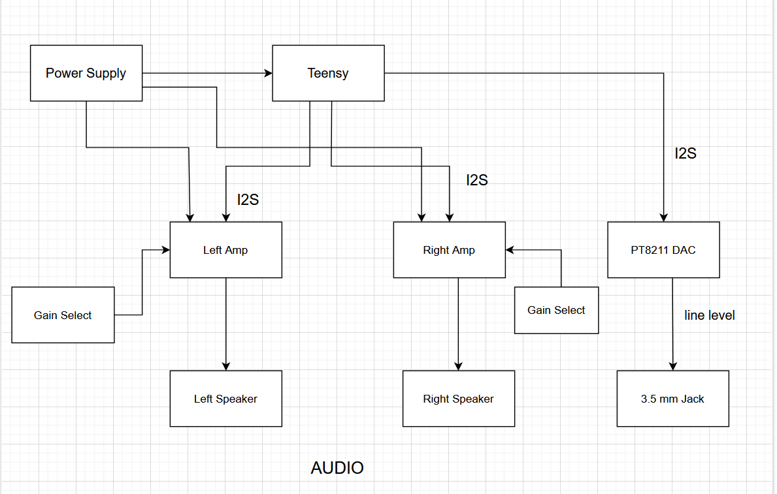
Audio Control Flowchart
Internal and external audio controller via touchscreen
I2S
6W on-board
Notes:
Ian

Slide 7
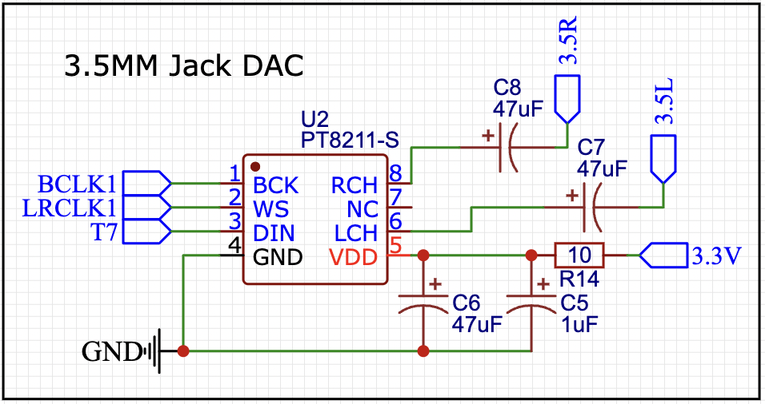
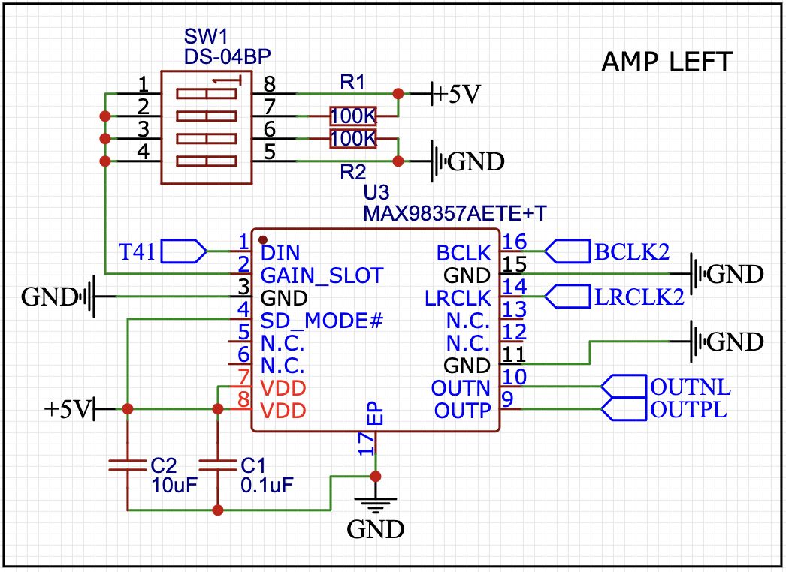
Audio Circuit Schematic
Left & Right internal audio
Dual 3W 4 ohm speakers
3dB, 6dB, 9dB, 12dB or 15dB
I2S
Stereo Output
16 Bit
3.5mm Jack
Notes:
Ian

Slide 8
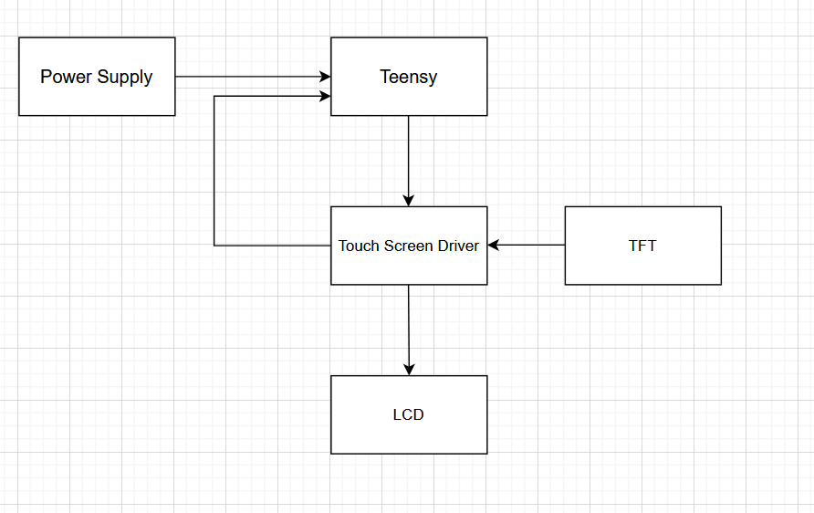
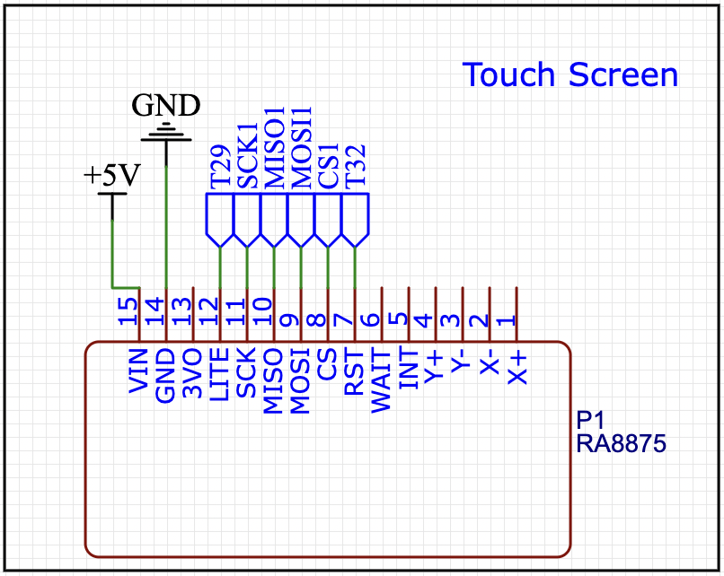
Touch Screen
800x480 Resolution
T29 PWM output for screen brightness
T32 reset active low
Separate SPI bus
Notes:
Drew

Slide 9
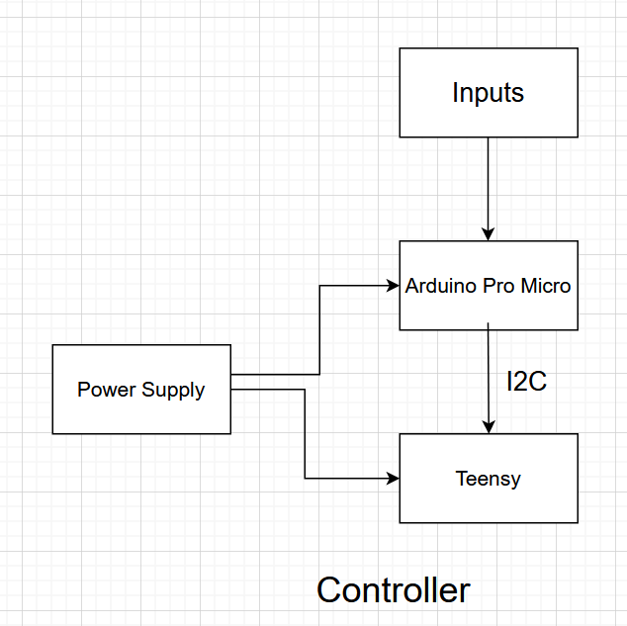
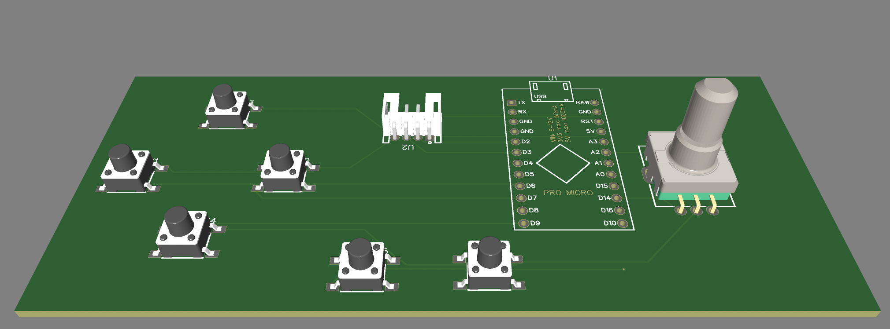
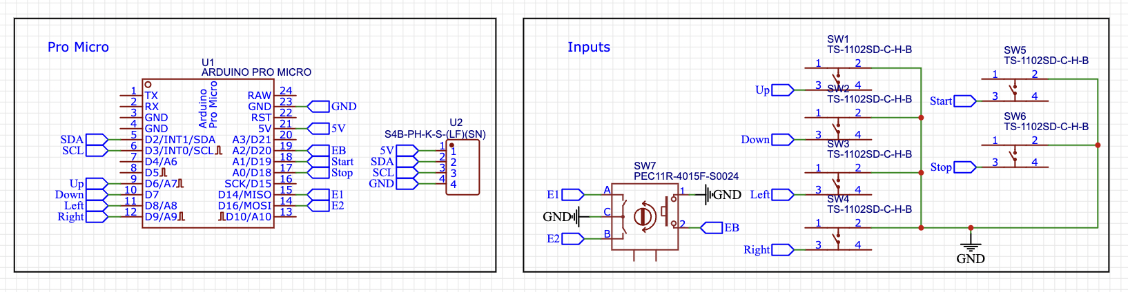
Controller Design
Notes:
Ian

Slide 10
Controller Software
2 Bytes transmitted via I2C
32bit / 100Kbit/s = 0.32ms
9.68ms * 16MHz = 154,880 clock cycles
0 1 0 1 0 1 0 1 01010101
Up Down Left Right Start Menu Encoder Direction Encoder Acceleration
Notes:
Ian

Slide 11
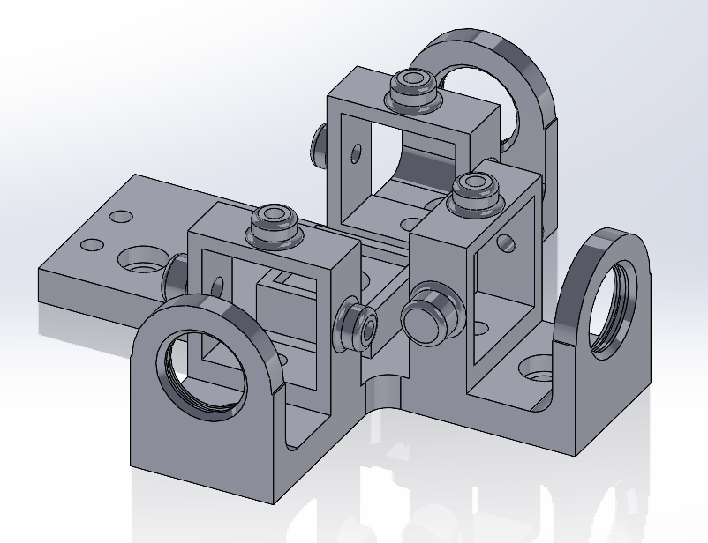
Laser Control
Our goal, as seen by the schematic, is to have three individual lasers (RGB)
These lasers are each to be controlled by the teensy using a data wire (On/Off)
Each lasers intensity can be controlled using a potentiometer
The lasers are affixed to a special mount that combines the laser into a “Xcube”
Notes:
Ian

Slide 12
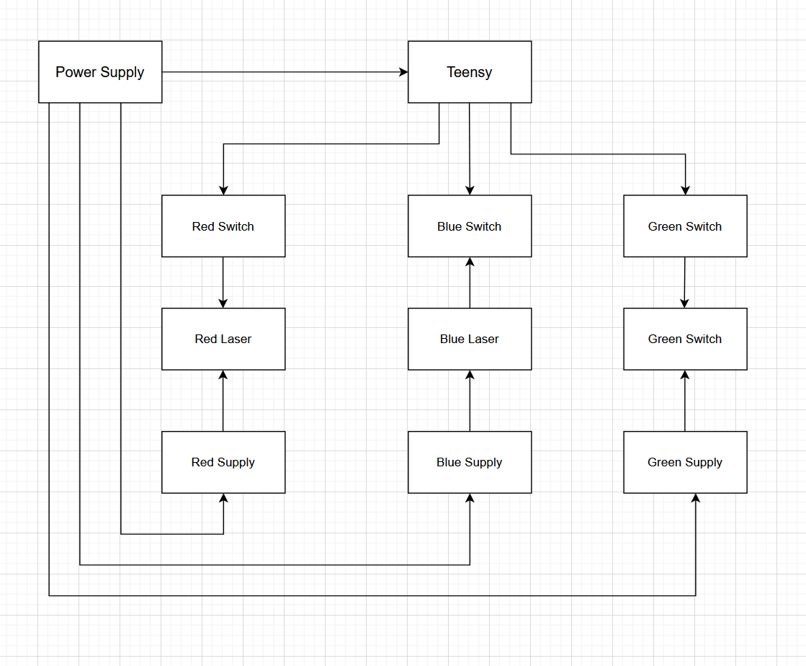
Laser Control Flowchart
Teensy sends our (ON/OFF) signal to each laser’s transistor
Depending on current laser’s voltage regulator, intensity can vary between each color
Ideally, when we have all colors on, we get a clean looking white color.
RB = Purple
RG = Yellow
GB = Cyan
RGB = White
Notes:
Ian

Slide 13
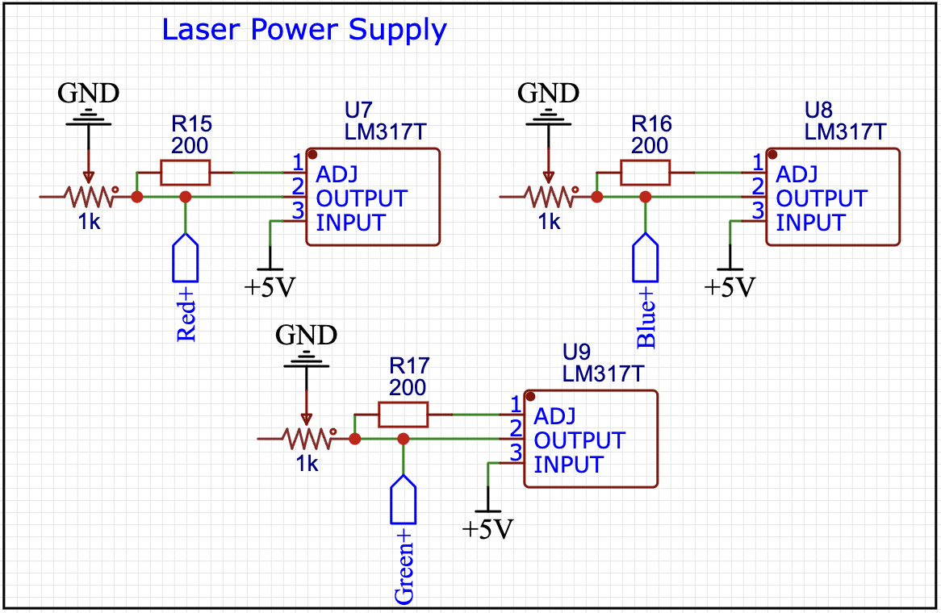
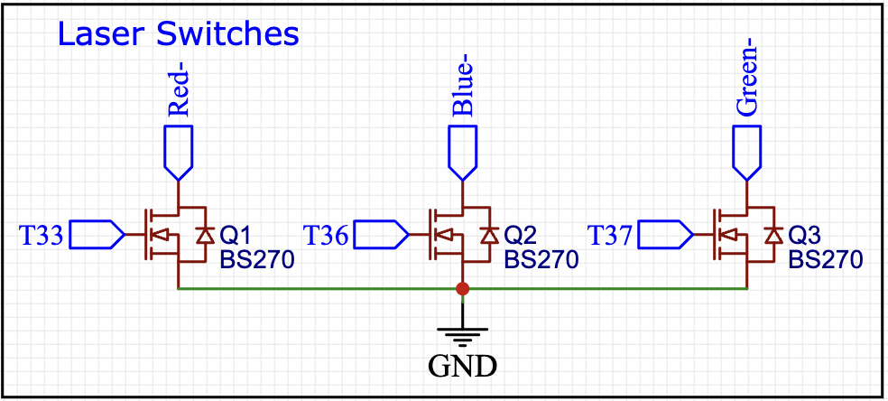
Laser Control Diagram
Vout = (1+500/200) = 3.5V
Vout = (1+100/200) = 1.5V
1.5A
50 MHz switching
400mA
10V
Notes:
Ian

Slide 14
Software
Notes:
Dom

Slide 15
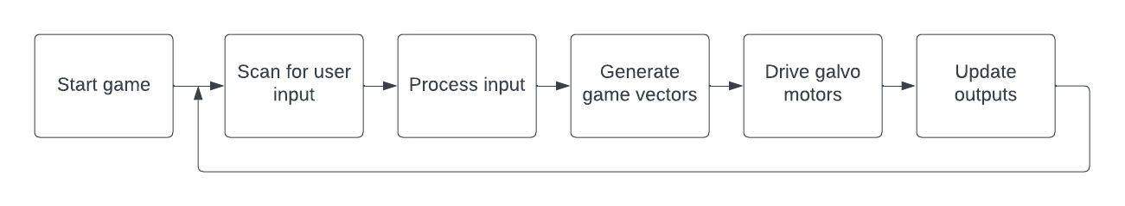
High Level Functions
Notes:
Dom

Slide 16
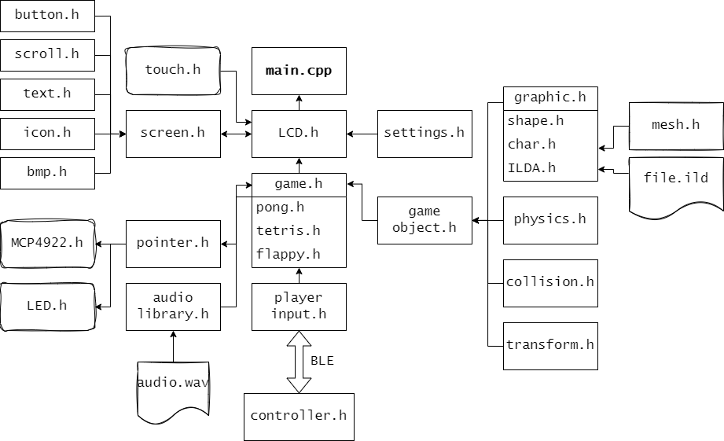
Overview
Goal: Interface with the various Hardware elements through a collection of easily expandable modules/classes.
Notes:
Dom

Slide 17
Input Interfaces
Interfaces that accept input from hardware
Controller.h
A class that accepts user input from the controller, and sends those inputs across bluetooth using two HC-05 Bluetooth modules in (master/slave) configuration. This class is loaded onto the ESP32.
Touch.h
A class that accepts user input from the lcd touch screen, find the x,y coords of the press and sends it to the LCD.h class for processing
Playerinput.h
A class that accepts bluetooth signals from the controllers, and pulls the relevant user input.
Notes:
Dom

Slide 18
Output Interfaces
Interfaces that control the hardware of the system.
MCP4922.h
Interfaces with the MCP4922 DAC, Sends data packets to the dac with the requested voltage signal. Signal must be activated using the LDAC signal
LED.h
Interfaces with the LEDs, Sends on/off signals to each of the LEDs based on the requested color of the laser pointer
LCD.h
Interfaces with the LCD screen. Checks inputs from the touch.h class and cross references with active UI elements in the screen.h class.
Notes:
Dom

Slide 19
Systems
Various systems that augment and change data
Game.h
Parent class that handles the game logic, including an update() function, a draw() function, a list of active game objects, score, player input, ect
Pointer.h
Wrapper class that handles all requests to move the galvos, also allows the printing of graphics
Physics.h
Physics class provides velocity and acceleration for a game object
Collision.h
Gives an gameobject a collision box that allows it to interact with other game objects.
Notes:
Dom

Slide 20
Data Classes
Settings.h
Stores information regarding the current settings of the system
GameObject.h
Represents an object in the game world. Has an associated graphic, transform, physics, and collision box
Graphic.h
Parent class containing graphic information for various objects to be printed
Shape.h
Graphic child containing a library of basics shapes to print, like squares, circles, triangles.
ILDA.h
Graphic child containing vertices of an associated ILDA file.
Char.h
Graphic child containing a library of basic characters [A-Z 0-9]
Sentence.h
Stores a collection of Char.h for printing. In order, allowing text to be displayed
Notes:
Dom

Slide 21
Data Classes Cont
Vec2.h
A vector holding two values, usually used to hold positional data
Transform.h
Data class that represents an object's location on a 2D plane, including position, rotation, and scale
Notes:
Dom

Slide 22
Pointer
(0,4095)
(4095,4095)
PointTo(Vec2 pos)
Points the laser to a position on the screen depending on the pos variable {0-4095,0-4095}
draw(Gameobject obj)
Draws obj.graphic at location obj.transform.pos
print(Sentence sen)
Draws sen.word at location sen.transform.pos
If letter in sentence goes over the bounds of the screen, it loops back around to the next line
(0,0)
(4095,0)
Notes:
Dom

Slide 23
MCP4922
The MCP4922, is a DAC that handles sending 0-5v signal, which is then converted into our -5-5v differential signal
In order to request our DAC to send out a specific signal, we must send it bytes via SPI bus
We handle sending these bytes using the first SPI bus of the teensy through the MCP4922.h library.
The only class that has access to sending data to the DAC, is our wrapper class Pointer.h
Notes:
Dom

Slide 24
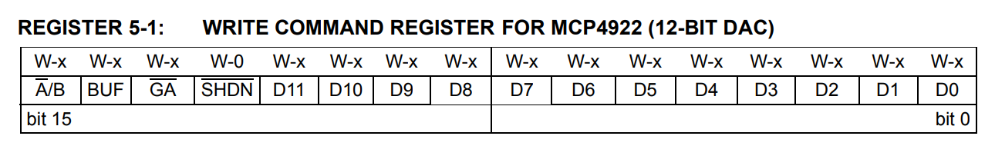
MCP4922 Byte format
A/B - DAC Channel Selection (X or Y Galvo)
BUF - Is this input data buffered (On by default)
GA - Gain of the output, (Low by default)
SHDN - Shutdown the DAC (useless, disabled by default)
D0-11 - u12 representing the output of the signal, 0-4095 -> 0-5v
https://ww1.microchip.com/downloads/aemDocuments/documents/OTH/ProductDocuments/DataSheets/22250A.pdf
Notes:
Dom

Slide 25
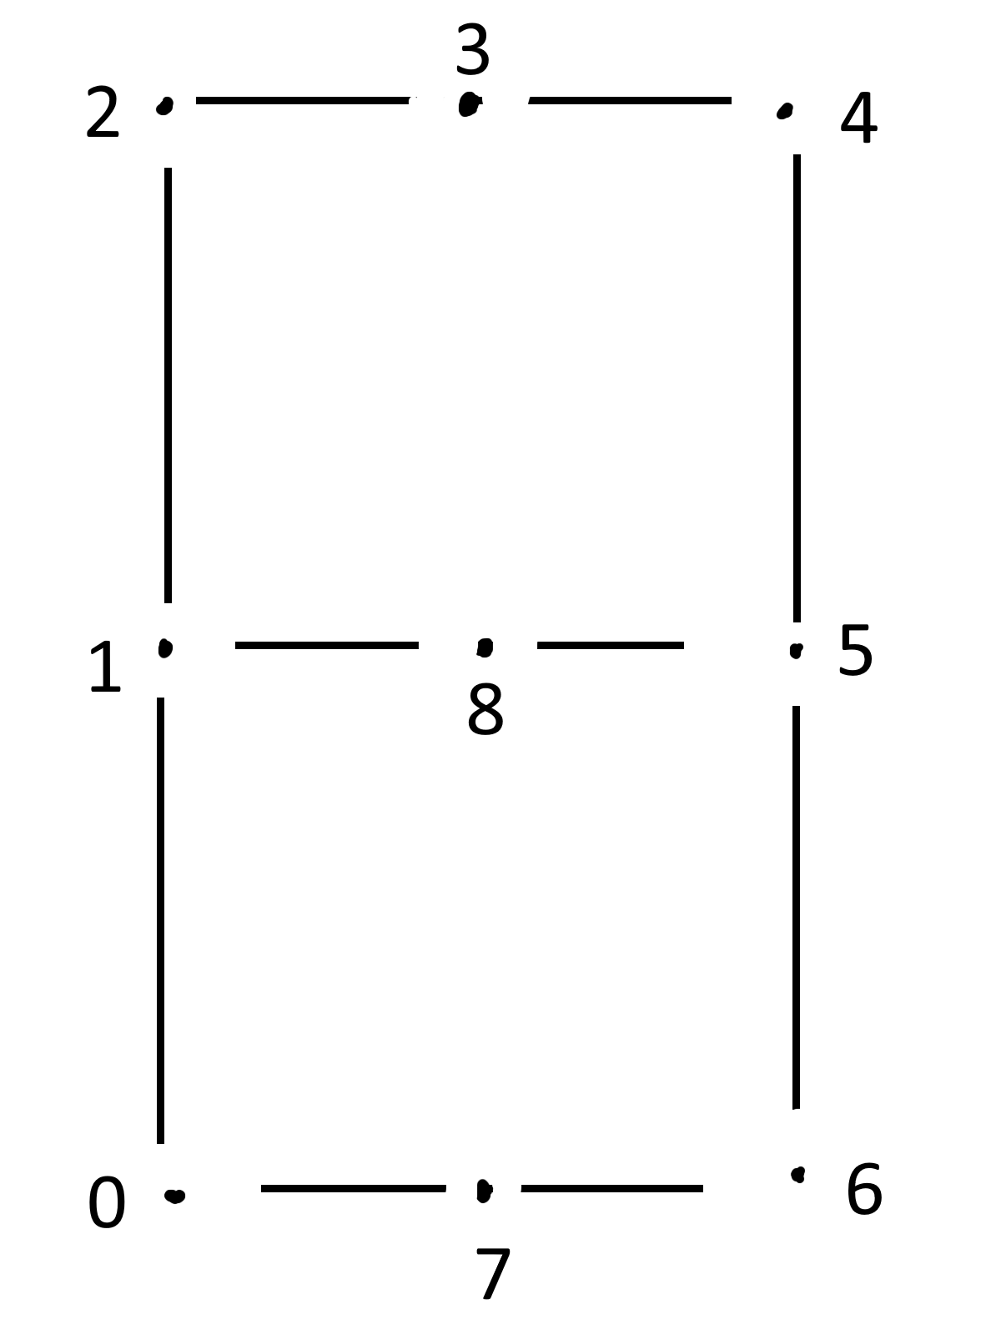
Mesh (Encoding characters)
Mesh.h handles encoding usable characters to print
Currently, characters are hand encodes as a series of vertices with associated led actions
For example, to write “R” we would store the array
[0,1,2,3,4,5,1,8,6]
Connect the dots!
Notes:
Dom

Slide 26
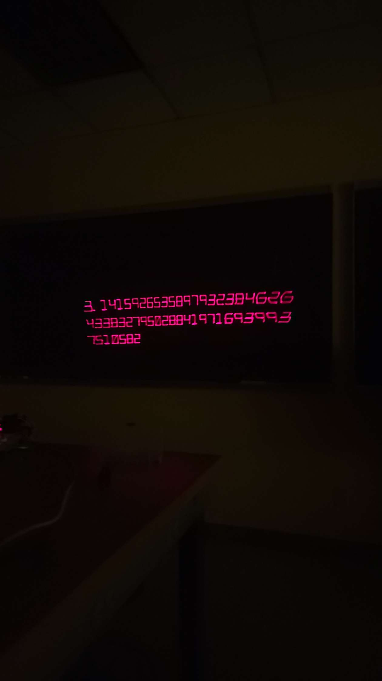
Sentence.h
A data class that contains a collection of Chars, usually used to represent a string
Kerning and font size controlled by Pointer.h
p.print(Sentence sen(“3.14159…”));
Currently only supports characters [A-Z0-9’ ‘], all other characters are simply ignores
Notes:
Dom

Slide 27
ILDA
ILDA, or International Laser Display Association, is a standardized file format that contains instructions for a laser projector.
ILDA.h is a file that parses these files, and converts them into a series of executable instructions that the pointer.h file can execute
ILDA files (*.ild) comprise of two byte formats, headers and records
Headers
Headers contain information regarding the ILDA file in its entirety
Records
Records contain the individual x,y,z coordinates to move the laser to, along with laser color and intensity
Notes:
Dom

Slide 28
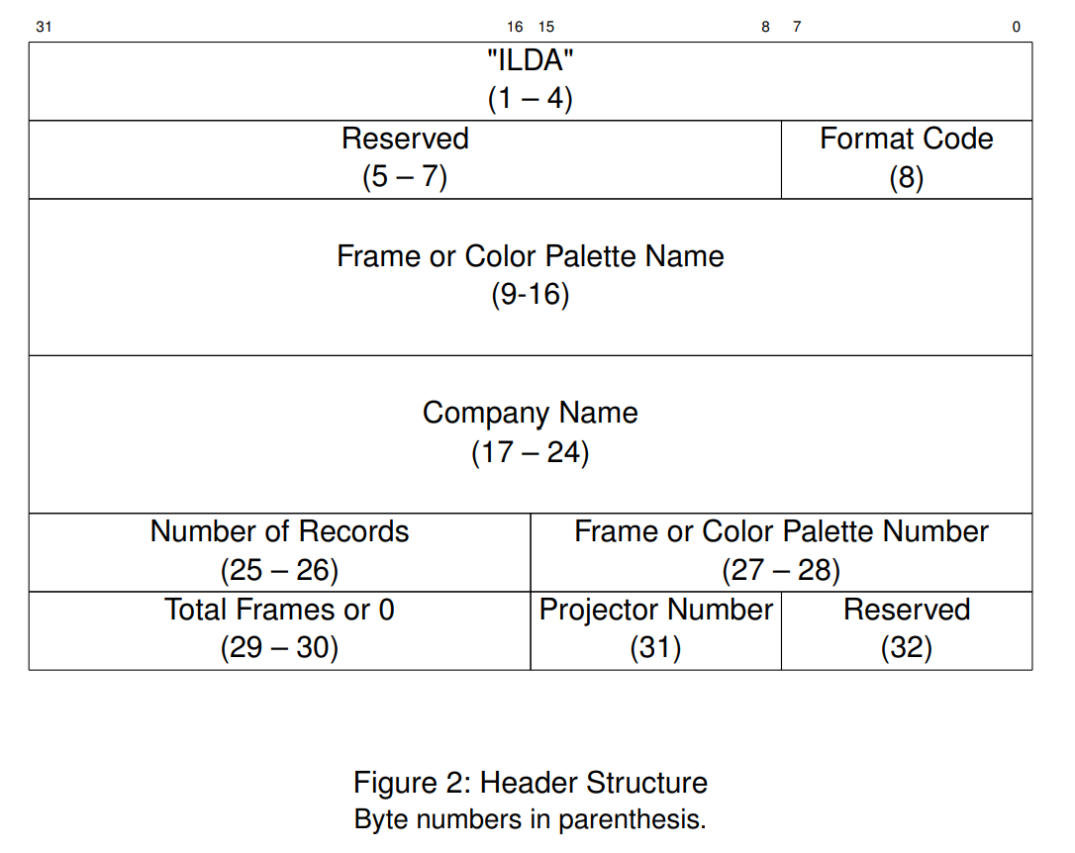
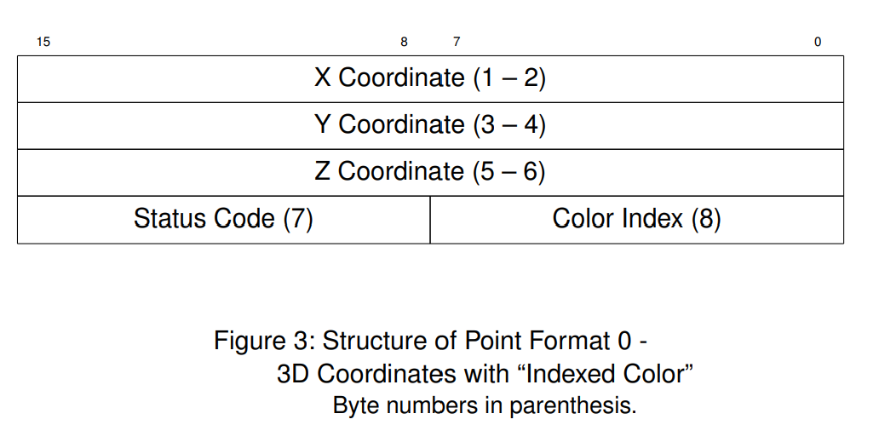
ILDA Byte Format
https://www.ilda.com/resources/StandardsDocs/ILDA_IDTF14_rev011.pdf
Notes:
Dom

Slide 29
Game Object
Object data class representing an ingame object (Paddles, ball, text, ect)
Contains the following data types
Transform
Where the game object is, rotation and position
Graphic
How to display the object, Is it a square? The letter “R”?
Physics
Physic parameters of the object
Collision
Collision box of the object, usually a box by default.
draw()
Draws the associated graphic of the object, can be a Shape, Char, or ILDA
update()
Updates the transform based on the physics and collision
Notes:
Dom

Slide 30
Physics and Collision
Collision.h
Each game object has an associated collision object
When running game updates, the game checks to see if if any two game objects are colliding, and adjusts their transform’s accordingly
Since collision algorithms are difficult, we will need to restrict collision boxes to Circles and Squares
Physics.h
Updates the physics of an object, allows the user to put a force on an object using several helper functions
ApplyForce(Vec 2)
set_acceleration(Vec2 = {0,-9.81})
Notes:
Dom

Slide 31
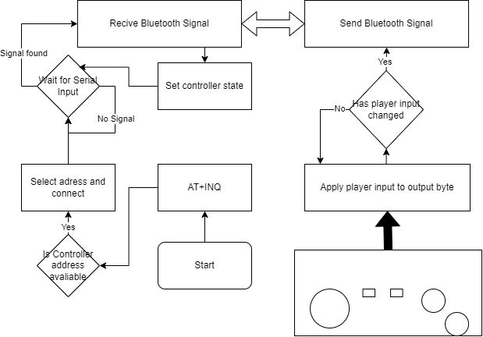
Controller Interface
Notes:
Dom

Slide 32
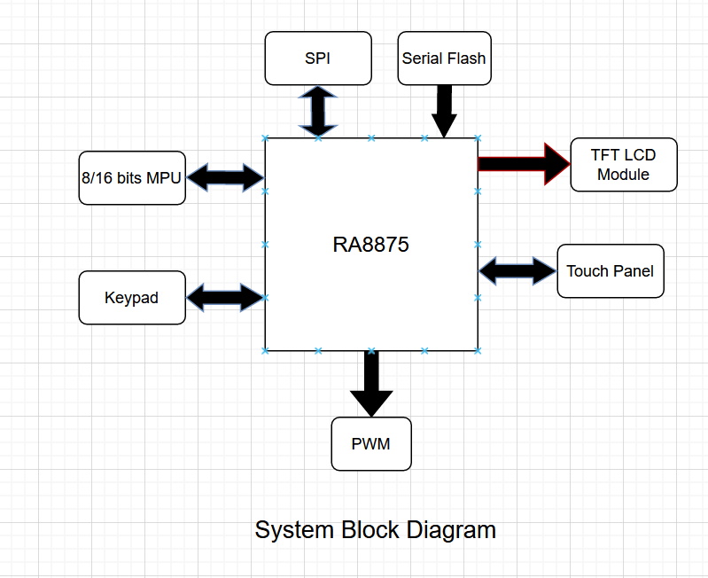
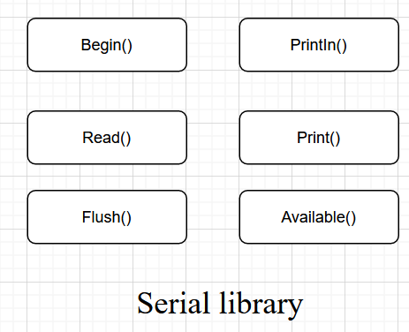
LCD
SPI.h
Allows to communicate with the devices
Adafruit_GFX.h
Declares common set of graphic functions on the LCD i.e. shapes or colors.
Adafruit_RA8875.h
Buffers the LCD display and interface allows for interaction read/write on the screen.
Allows for a range of hardware accelerated shapes.
Notes:
Drew/Adi

Slide 33
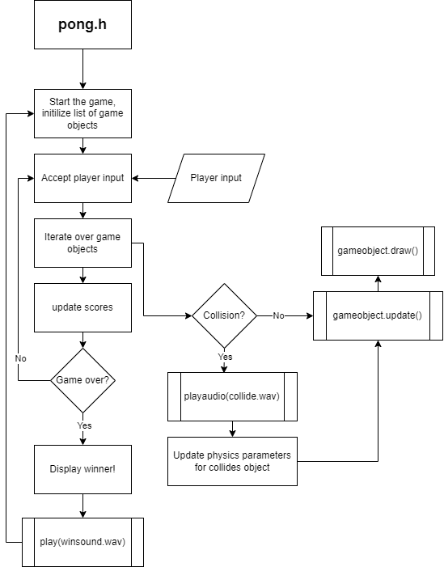
Primary Game Loop
The primary game loop that runs all pong game logic

Slide 34
LCD and UI
The LCD will show various ui elements using the basic ui primitives
Button.h
Scroll.h
Text.h
Icon.h
Bmp.h
These primitives will be stored in a screen.h class, which controls layer priority and button logic
Below are some early mockup designs for what the LCD-UI will look like
Notes:
ADI/Drew

Slide 35
CAUTION: FAST MOVING LASER
AVOID DIRECT EYE CONTACT

Slide 36
Select Game
Demo
Settings

Slide 37

<
>
Pong

Slide 38

Audio
Screen
About

Slide 39
Brightness
Up
Down

Slide 40
Audio
Internal
External
Volume

Slide 41
Software Summary
Notes:
dom

Slide 42
Current issues with the project
Balancing laser intensity between the Red, Green, Blue Lasers
Not all laser are created equal, our current red and blue lasers are inadequate intensity
Laser mount
There is a clearance issue with one of the galvo driver boards, revisions of design is needed
Lasers tend to become unaligned after extended periods of use, consider using a tougher material for the mount?
Heatings issues (Case Design)
Galvo drivers are currently causing the most heat
Wire clutter (Case Design)
The unit looks like a piece of electronic waste, we need to pretty this thing up, or throw it in a box
No working prototype for controllers
Having issues getting the batteries to work properly on the wireless controllers, might need to plan ahead and use the wired version
No working prototype for LCD screen
Notes:
Dom

Slide 43
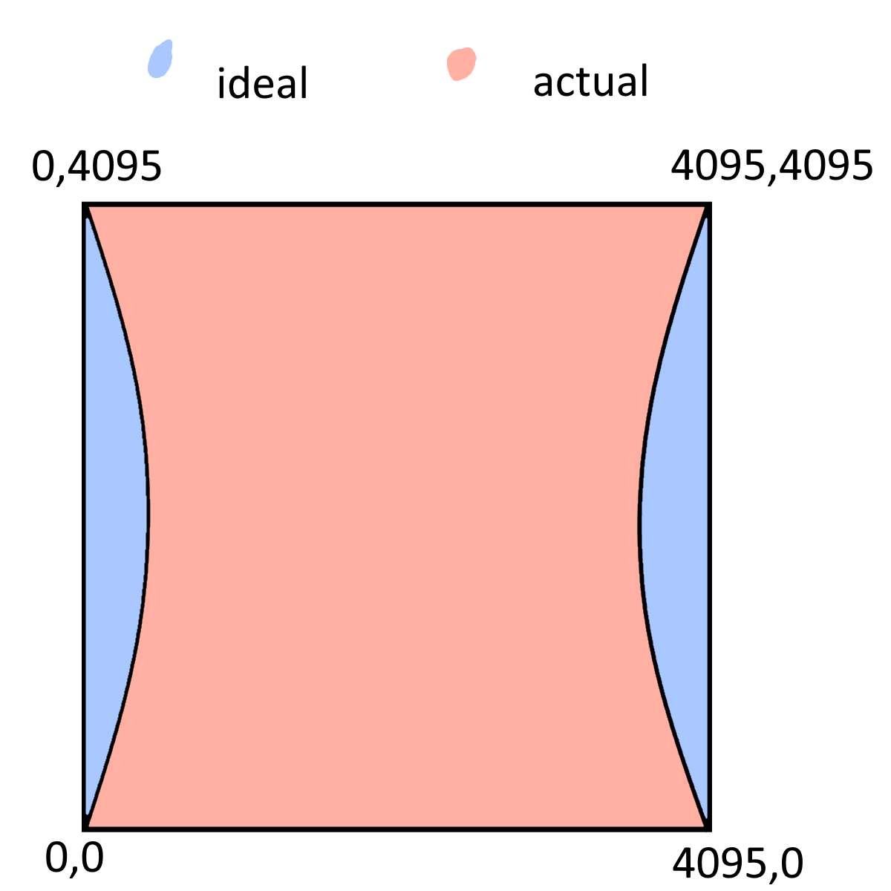
Current issues with the project (Cont.)
Screen distortion
Caused by the order that the laser enters the galvo mirrors, not fixable in code, would need to be addressed with some sort of lens.
Notes:
Dom

Slide 44
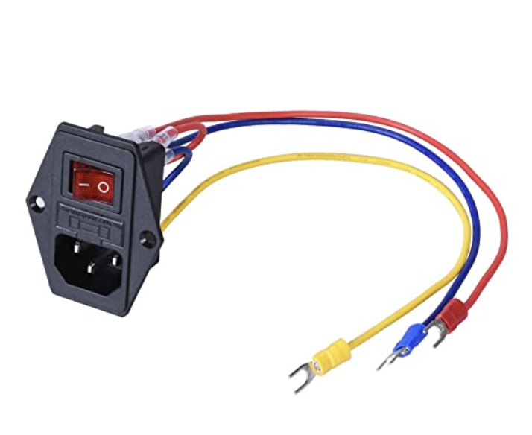
Safety and Risk Mitigation
1.66mW per laser
Caution screen
Heatsink
Case
Notes:
Adi

Slide 45
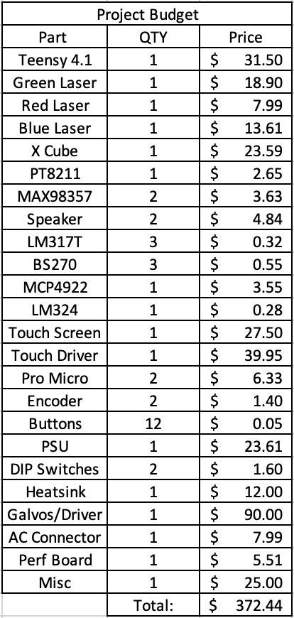
Budget
Notes:
Drew

Slide 46
Current Steps
Week | Tasks/Goals
1 (01/16/23-01/20/23) | Figure team schedule
2 (01/23/23-01/27/23) | Work on PDR slides
3 (01/30/23-02/03/23) | Present PDR slides
4 (02/06/23-02/10/23) | 2D motion control
5 (02/13/23-02/17/23) | Laser power control
6 (02/20/23-02/24/23) | Display multiple objects
Week | Tasks/Goals
7 (02/27/23-03/03/23) | Controllers
8 (03/06/23-03/10/23) | Code a library to display basic shapes
9 (03/13/23-03/17/23) | Code pong
10 (03/20/23-03/24/23) | Display Pong using library
11 (03/27/23-03/31/23) | Troubleshooting
12 (04/03/23-04/07/23) | Functioning Laser Projector
13 (04/10/23-04/14/23) | Expo Presentation
Notes:
Dom

Slide 47
Next Steps
Week | Tasks/Goals
(Spring break) 9 (03/13/23-03/17/23) | Spring Break, Refactor library, rewrite drawing functions, refactor code, improve performance, document code, conform code to current flowchart. (DOM) Create new design for laser mount, and get multiple colors operational, allow for easy adjustment to the laser, with acceptable drift of laser accuracy. (IAN) GET LCD in a state where we have buttons that direct to others screen, or modify a variable. (DREW,ADI)
10 (03/20/23-03/24/23) | Controllers controllers!!!!!, We need to finalize our controller design Wired, or wireless? Using 4 AA batteries to power the ESP32. Connect controllers to the unit and accept input, allow game to be controlled by a user. (IAN) Factor the current LCD code into the main branch, getting the LCD operational at this point is critical. LCD need to be able to control the unit, what game is being played, basic volume control, (DREW,ADI,DOMINIC)
11 (03/27/23-03/31/23) | Refactor design into final stage. Get a case design finished, finalize hardware components and finish final design. Start building external UI ports on the case. Put heat sinks on all units. REWIRE EVERYTHING TO LOOK A LOT NICER IN THE NEW CASE (IAN) Get audio system finalized, system to play audio on command, through a pair of internal speakers (IAN) Get Controller input working with the current design i want to see this currently playable, free time goes to making a flappy bird game or helping other people (DOM) Work on LCD Graphics, Implement the nice symbol pack that we got from Ians friend, make it look appealing and pleasant(DREW,ADI)
12 (04/03/23-04/07/23) | IEEE Presentation on April 3rd. Take notes, What went well, What worked? Get feedback on possible improvements or ideas from the audience. This week is dedicated to getting this ball of wires in an operational state for the expo. Plan out what players will do, how they will interact with the presenters, get everything working Bug fixing, god knows that there will be tons of bugs in this project. GRAB YOUR SLEEPING BAGS, I WANT YOU LIVING IN THE SENIOR LAB THIS WEEK! WE ARE ON CRUNCH TIME PEOPLE No more adding new additions to the system, we are stuck with what we have at this point. Refine your ball of dirt, rather than adding on to it!
13 (04/10/23-04/14/23) | April 13th Expo Presentation. Ideally, all work on the unit is done at this point, work this week will be dedicated to promotional material for the unit, Con-ops, powerpoints, creating demo ILDA files, ect… Make more ILDA files, Make promotional video showcasing all the capabilities of the unit Plan out what we will say to the judges. Clean up the unit for a file display
Notes:
Dom

Slide 48
References
https://ww1.microchip.com/downloads/en/devicedoc/atmel-7766-8-bit-avr-atmega16u4-32u4_datasheet.pdf\
https://www.ti.com/lit/ds/symlink/lm317.pdf
https://ww1.microchip.com/downloads/en/devicedoc/22250a.pdf
https://www.analog.com/media/en/technical-documentation/data-sheets/MAX98357A-MAX98357B.pdf
https://www.ti.com/lit/ds/snosc16d/snosc16d.pdf
https://www.pjrc.com/store/pt8211.pdf
https://cdn-shop.adafruit.com/datasheets/RA8875_DS_V19_Eng.pdf
https://www.onsemi.com/pdf/datasheet/bs270-d.pdf

